Slide 1
Positive Behavior Support Techniques and interventions for Teachers With Exceptional Learners
Presented By:
Craig Dippolito
Image reference:
http://www.front-reviews.com/special-education-teacher-blogs/

Slide 2
THE CHANGING ROLES AND DUTIES OF THE SPECIAL EDUCATION TEACHER
No longer teaching in self-contained classes, special education teachers must now master the skills necessary to co-teach in an integrated classroom environment.
Five (5) critical roles in which special educators must become highly proficient.
Data-driven decision maker – Must be able to use assessment data to determine student eligibility for additional assistance.
Implementer of evidence-based intervention – Must have subject matter knowledge as well as knowledge of instructional strategies across subjects.
Implementer of socioemotional/behavioral supports (i.e., manager of behavior) – Must manage classroom behavior, implement positive behavioral support techniques and take into account cultural differences among the varying proficiency levels of students.
Differentiator of instruction – Must implement required student accommodations, determine the effectiveness of these accommodations and determine whether adjustments are needed.
Collaborator – Must be able to effectively collaborate with co-teachers, parents, administrators and state and local school boards to achieve shared student achievement goals.
Reference: (Polloway 34)

Slide 3
Behavioral challenges in the integrated classroom
Frustration: Students with learning disabilities can often get frustrated and “check out” when they are unable to comprehend the material being taught in an integrated classroom.
Truancy – A student’s attendance can suffer if the student feels uncomfortable or unwelcome in an integrated classroom. Lack of attendance compounds the ability to master required subject matter.
Tantrums – A student who is frustrated may display outward signs of disapproval of the class by lashing out in various different ways.
Image Reference: https://www.helpguide.org/wp-content/uploads/2018/11/boy-clutching-head-reading-350.jpg
Reference: Haddad, D. (2019, July 18) How Learning Disabilities Can Affect Behavior. Retrieved from https://www.verywellfamily.com/how-learning-disabilities-can-affect-behavior-2161916

Slide 4
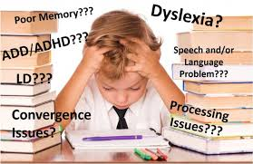
Behavioral Warning Signs of a Learning Disability
Refusing to follow classroom rules in order to be removed from the classroom and avoid doing work.
Avoiding doing homework assignments.
Saying the work is too difficult.
Exhibiting physical ailments (i.e. stomach aches, headaches, anxiety, and /or depression).
Blaming the teacher for bad grades.
Refusing to do an in-class assignment or task.
Saying derogatory comments about his/her own abilities such as, “I’m stupid. I give up. I can’t do it.”
Refusing to communicate with teacher about assignments
Skipping class.
Bullying peers.
Image Reference: https://kidsspeak.info/what-are-learning-disabilities/
Reference: Haddad, D. (2019, July 18) How Learning Disabilities Can Affect Behavior. Retrieved from https://www.verywellfamily.com/how-learning-disabilities-can-affect-behavior-2161916

Slide 5
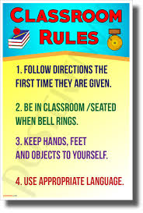
Guidelines for establishing and enforcing classroom rules
Establishing Rules:
Fewer is better – The more rules that a teacher has, the more likely it is for students to get confused about what is expected of them. Keep them few and simple.
Clearly Defined – Rules must be unambiguous and easy for students to understand and follow.
Positive Language – Rules should be expressed in positive language rather than in negative. Avoid “Don’t do” this or that.
Specific Consequences - Rules must have established and uniform consequences for all students who break them. Student favoritism or bias must be avoided at all costs.
Enforcing Rules:
Consistency, Consistency, Consistency – Rules will be ineffective if they are not enforced consistently throughout the day and the school year.
Consequences – Must be uniform and appropriate under the circumstances. Should be used to eliminate future infractions.
Image Reference: https://images-na.ssl-images-amazon.com/images/I/817CHjXw85L._SY606_.jpg
Reference: (Polloway 59)
Notes:
Not surprisingly, the potential influx of money from the federal government drastically changed the influence it had on the states. While initially, federal education laws were designed to hold the states accountable, in recent years the focus has changed from accountability to accounting. The lure of federal money as well as the need for said money to implement the federal testing guidelines has become a necessity for most states. Therefore, today the federal government has, in essence, taken over complete control of most states’ standardized testing guidelines.

Slide 6
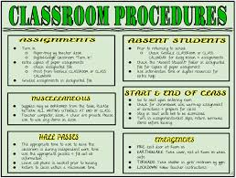
Guidelines for establishing and enforcing classroom PROCEDURES
Establishing Procedures:
Clearly defined procedures must be established for the following:
Group work
Seatwork
Teacher-led instruction
General behavior
Beginning and ending class
Transition in and out of the classroom, and
Use of all materials and equipment
Model Behavior:
Teachers must model or demonstrate to the class all of the procedures to insure student understanding.
Enforcing Procedures:
Teachers should require students to properly carry out any and all procedures that are not being done correctly the first time.
Image Reference:
: https://encrypted-tbn0.gstatic.com/images?q=tbn:ANd9GcR33aTUhz8DGbgkZ9u8OybzTSpvKgukX2TW0tPU6lVzcrfVXOit1Q
Reference: (Polloway 57)

Slide 7
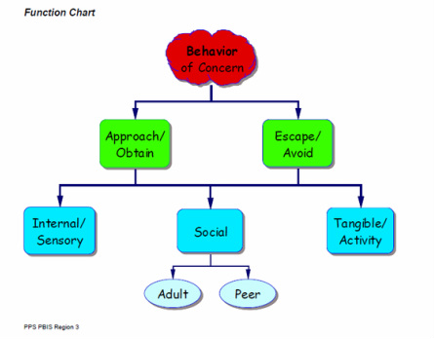
STEPS TO DEVELOPING A FUNCTIONAL BEHAVIORAL ASSESSMENT (FBA) – SLIDE #1
Purpose of FBA: To provide a contextual view (cause) of specific behaviors and behavioral patterns. (Polloway 48)
Steps:
Establish a Team – should include the general education teacher, special education teacher, related services personnel (ie. speech coach, occupational therapist), paraprofessionals (guidance, therapists) and the parents.
Identify the Interfering Behavior - Team members identify the interfering behavior that is most problematic for the learner.
Collect Baseline Data –
Review previous and current records.
Conduct formal and informal interviews with school staff, family members, and the student
Image Reference: https://www.pps.net/cms/lib/OR01913224/Centricity/Domain/178/1395169423.jpg
Reference: (Polloway 48-52)

Slide 8
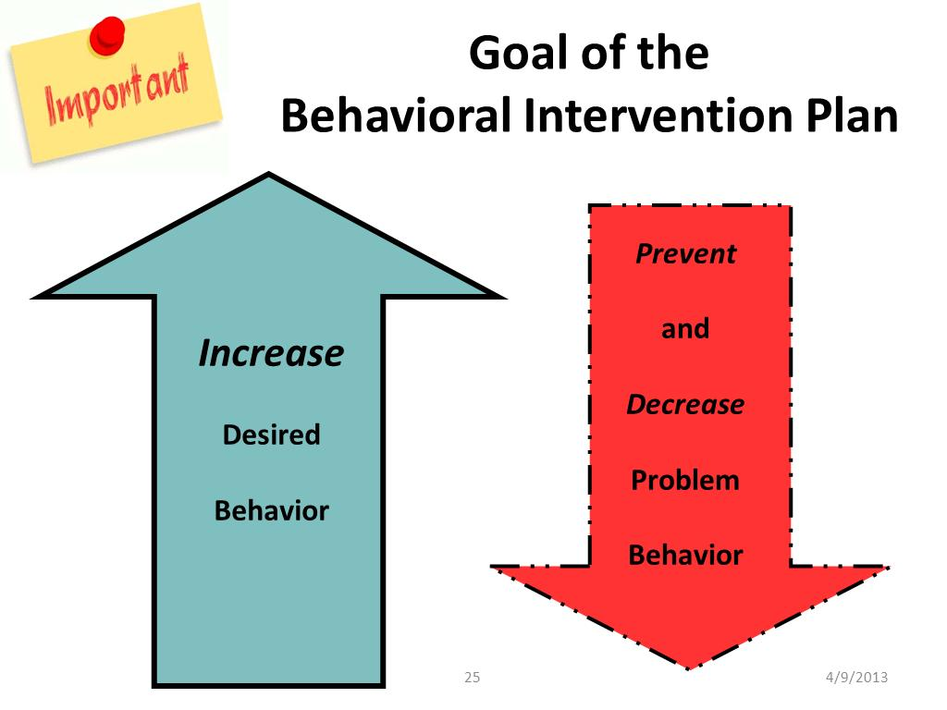
STEPS TO DEVELOPING A FUNCTIONAL BEHAVIORAL ASSESSMENT (FBA) – SLIDE #2
Steps con’t:
Develop a Hypothesis Statement – use assessment results to identify patterns of negative behavior across time and differing environments.
Hypothesis should include:
the setting events, immediate antecedents, and immediate consequences that surround the interfering behavior.
a restatement and refinement of the description of the interfering behavior that is occurring, and
the function the behavior serves (i.e., get/obtain, escape/avoid).
Carefully Test the Hypothesis – Teachers test the hypothesis by modifying the setting/activity to increase the probability that the behavior occurs.
Develop Interventions (BIP) – Teachers focus on developing comprehensive intervention plans that increase learners’ use of more appropriate behaviors to achieve their goals and reduce the occurrence of the interfering behaviors.
Image reference: http://www.cfn211.com/uploads/7/9/9/0/7990034/6323298_orig.jpg
Reference: (Polloway 48-52)

Slide 9
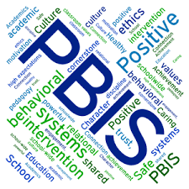
Benefits of USING POSITIVE BEHAVIORAL SUPPORTS
Defined: a behavior management system used to understand what maintains an individual student’s challenging behavior and what positive reinforcements can be used to curb said behavior.
Benefits:
Respects the dignity of the individual – behavioral supports are individualized to the student and “cookie cutter” approaches are avoided. Students hear positive words from their teacher and ovoid being constantly reprimanded for behaviors they cannot always control.
Designed to create positive change – through positive reinforcement and environmental changes, students are given every opportunity to learn in a relaxed and reduced-stress setting. Teachers avoid separating or removing students from their learning environment which increases their opportunity to comprehend the required academic content.
Outcome Focused – the supports are designed to limit student outbursts and therefore provide an overall safer environment for learning for all.
Image Reference: https://www.shorelineschools.org/cms/lib/WA02217114/Centricity/Domain/367/wordle-pbis.png
Reference: Wynsberghe, A.V. (2018, July 8) The Benefits of Positive Behavior Support. Retrieved from: https://psychcentral.com/blog/the-benefits-of-positive-behavior-support/

Slide 10
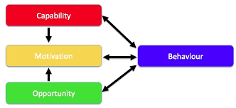
Using Social Interventions to Correct behavior
TEACHING SOCIAL SKILLS: Although a teacher’s primary responsibility is to teach academic content to their students, teaching social skills can be just as important for overall student success in the classroom.
Types of Social Skills:
Communication and sharing
Cooperation
Limits setting
Problem solving
Friendship making
Development of confidence.
Teaching Activities:
Setting Clear Expectations Through Rules and Procedures – Drill rules and Procedures Daily
Soft Tone – Avoiding loud outbursts and yelling at students creates a more relaxed place to learn.
Games, Games, Games – Allow students to compete, interact and socialize with each other in a relaxed environment.
Image Reference: https://www.google.com/imgres?imgurl=https%3A%2F%2Fwww.shponline.co.uk%2Fwp-content%2Fuploads%2F2015%2F07%2FCOM-B-3.jpg&imgrefurl=https%3A%2F%2Fwww.shponline.co.uk%2Fbehavioural-safety%2Fsafety-behaviour-change%2F&docid=SF4_RO9xBxaefM&tbnid=_-1mL1oXrgBs1M%3A&vet=10ahUKEwim-5Kd5_XjAhXjuFkKHbqFDuQQMwhiKBMwEw..i&w=834&h=382&safe=active&bih=625&biw=1366&q=Using%20Social%20Interventions%20to%20change%20behavior&ved=0ahUKEwim-5Kd5_XjAhXjuFkKHbqFDuQQMwhiKBMwEw&iact=mrc&uact=8
Reference: (Polloway 67)

Slide 11
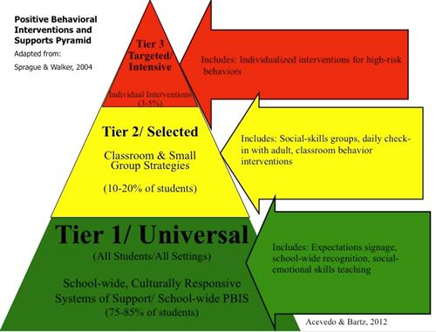
Positive Behavior Support (PBS) (SLIDE #1)
Purpose: Use a non-aversive school environment to support the quality of every student’s life as well as their academic and social experiences.
Includes:
Assessing and redesigning the school and classroom environment
Teaching social skills, and
Reinforcing desirable behaviors while intervening on disruptive behaviors.
Teacher Focus:
Instructional procedures and avoiding of interventions that involve pain and stigmatization.
Supporting observable and measurable behavior
All interventions are based on an understanding of and respect for a person’s life, circumstances, preferences, and goals.
School Focus:
Must create a climate of competence and mutual respect throughout the entire school to insure student compliance and uniform enforcement.
Image Reference: https://www.jackson.k12.ms.us/cms/lib/MS01910533/Centricity/Domain/963/PBISPyramidImage.jpg
Reference: (Polloway 45)

Slide 12
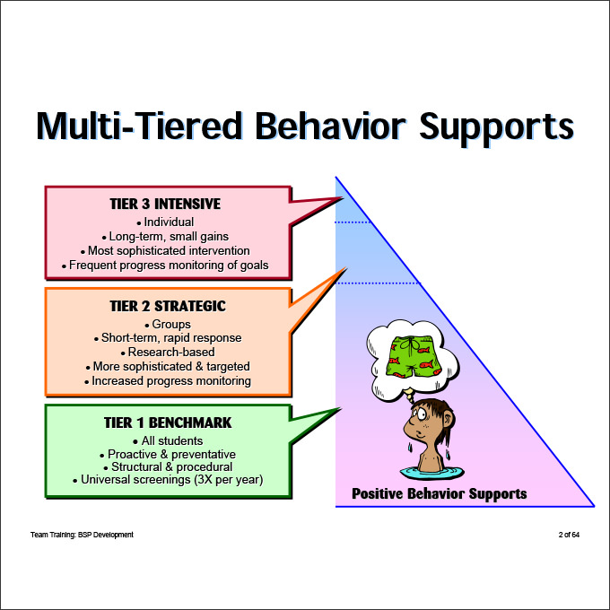
Positive Behavior Support (PBS) (SLIDE #2)
Image Reference: https://nationalgriefaw.b-cdn.net/wp-content/uploads/2018/01/positive-behavior-support-plan-positive-behaviour-support-plan-template.jpg

Slide 13
Preparing the instructional environment for exceptional learners
Classroom Setup Should Include:
Sense of community - Students need to feel welcome in a classroom.
Personal territory – Some space should be allotted to each student to keep personal items.
Flexibility - The environment must allow itself to be manipulated by its users so that spaces can be changed. Variety adds to excitement for learning.
Authentic motivation – Classroom should create intrinsic motivation to learn by including the following factors: (Polloway 56)
Collaboration (learning together in teams)
Content (must be relevant and meaningful), and
Choice (opportunities to make a decision about what is learned)
Posture Flexibility – The classroom should offer a variety of seating and work-surface heights to accommodate individual styles.
Barrier Free – Space should allow for the free flow of all students regardless of their disability.
Image Source: https://encrypted-tbn0.gstatic.com/images?q=tbn:ANd9GcSscYnvloJXcXWNkXAM6SCOAmTRmqZ3BJCChca8zT7BzGK56tCA
Reference: (Polloway 56)

Slide 14
CONCLUSION
The challenge of teaching exceptional students can be a difficult one. However, when a teacher and a school focus on providing positive feedback in a positive learning environment, overcoming this challenge becomes not only a lot easier, but also a lot more satisfying. Staying positive leads to a better attitude for all involved and that will always lead to better opportunities for all students to learn. Negativity leads to stress and anxiety which are barriers to learning that must be avoided at all times, especially when teaching exceptional learners.
Image Reference: https://www.naset.org/typo3conf/ext/t3site/Sites/Main/Resources/Public/Images/home_mobile.jpg

Slide 15
SOURCES:
Book(s):
Polloway, Edward A., James Patton, Loretta Serna, Jenevie Bailey. Strategies for Teaching Learners with Special Needs, 11th Edition. Pearson, 20170403. VitalBook file.
Website Articles:
Haddad, D. (2019, July 18) How Learning Disabilities Can Affect Behavior. Retrieved from https://www.verywellfamily.com/how-learning-disabilities-can-affect-behavior-2161916
Wynsberghe, A.V. (2018, July 8) The Benefits of Positive Behavior Support. Retrieved from: https://psychcentral.com/blog/the-benefits-of-positive-behavior-support/
Image references are located below each image within the presentation.
Notes:
.

